Slide 1
CHAPTER 4:
COFFEE
CLASS, DISTINCTION,
AND “GOOD” TASTE
© 2017 Taylor & Francis

Slide 2
Class and social mobility
People with similar levels of income, wealth, education,
occupational prestige, lifestyle, social status and/or access to material goods and services.
Classes are distinguished not only by the kind of work they do, but also by consumption of different goods in different ways.
Social mobility: change in class position from one’s family of origin.
• Has there been social mobility between your grandparents’ and your parents’ generations?
• Do you anticipate that there will be some between your parents’ generation and your own?
© 2017 Taylor & Francis

Slide 3
Conspicuous consumption and status
Veblen: consumption of highly visible luxury goods to signal elite status.
person’s of group’s prestige or rank in society.
own any designer clothing or accessories?
how do you decide which designer’s wares to buy?
uch is it reasonable to pay for a cup of coffee?
ur parents and friends this question. If their answers differ you think that is?
friends give roughly the same answer, does it mean that l have roughly the same income levels?
Status: a
• Do you
• If yes,
• How m
• Ask yo , why do
• If your
they al
© 2017 Taylor & Francis

Slide 4
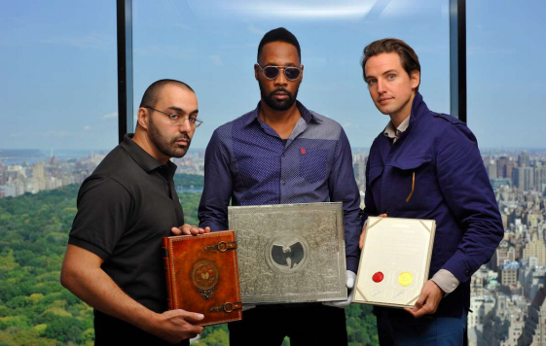
Conspicuous consumption and status (continued)
• Martin Shkreli bought the sole copy of a recording by Wu-Tang Clan, but was not planning to listen to it immediately. Why, then, did he buy it?
© 2017 Taylor & Francis

Slide 5
Expenditure cascade and
upscale emulation
High-status consumption items “trickle down” to lower
classes in an “expenditure cascade”: expectations and expenditures by lower classes expand.
Schorr: upscale emulation is an attempt to emulate lives of elites, primarily celebrities.
• “New consumerism”: not keeping up with the Joneses, but with the Jolie-Pitts.
Aspirational gap: consumption desires consistently outrun incomes.
Once an item is widely popular, its value for conspicuous consumption is lost.
© 2017 Taylor & Francis

Slide 6
Bourdieu: class and “good taste”
High-status consumption and wealth are related, but their relationship is culturally complex.
Consumption habits (tastes) both reflect and reinforce inequalities.
• It is not enough to be able to afford a consumption item. One must know which item to choose and how to consume it.
Social inequality is naturalized as individual good taste.
• Is there a brand of coffee you avoid? Why?
• Do all your friends agree on which brands to drink and which to avoid?
• Have you ever told someone (or been told by someone) “I don’t know how you can drink that stuff”? What “stuff” was referred to? Was its poor taste the only reason for the remark?
© 2017 Taylor & Francis

Slide 7
Three forms of capital
Economic: money.
Social: access to resources (support, information, opportunities) through an individual’s social network.
• “It’s not what you know, but whom you know.”
Cultural: knowledge, skills and preference highly valued within a particular culture.
• Your professor has invited you to a party at the Department of
Sociology. What will you talk about with people you meet there?
These forms can be exchanged for one another.
One may be high on one form of capital, but lacking in another.
• Name a social group high on economic capital, but low on cultural one. How about a group high on cultural capital, but low on economic one?
© 2017 Taylor & Francis

Slide 8
Types of cultural capital
1. Embodied in individual behavior;
• Do not use contractions in your university papers!
• Don’t fidget during a job interview!
2. Objectified in possessions;
• Do you have posters in your room? Which ones?
3. Institutionalized: conferred and verified by institutions.
• Are you certified as anything, from life-guard to MBA?
• What certifications do you wish to acquire? Why?
© 2017 Taylor & Francis

Slide 9
Public space
An area that all persons have the legal right to access, and from which they cannot be barred without cause.
Coffee chains offer a (quasi-public’ space.
• What is the difference between public and ‘quasi-public’ space?
• Have you ever seen mall or shop security guards escort anyone off the premises? Do you know why they did that?
• Would the police escort anyone off a square or out of a park for the same reason?
© 2017 Taylor & Francis

Slide 10
Third place
First place: home.
Second place: workplace.
Oldenburg: third place is a space where individuals can gather and interact with people they might not meet otherwise
(including people from different classes).
• What is you favorite “third place”?
• Do you use your “third place” as a substitute “first” or “second place”?
• Do you ever speak to strangers there?
• Where are you most likely to speak to strangers?
Provides foundation for local democracy and community solidarity.
• Is your favorite coffee shop more of a “third” or a “second place”?
© 2017 Taylor & Francis

Slide 11
Coffee in a global commodity chain
Commodity chain: the path a commodity takes from its conception and design, through manufacturing, retailing and consumption, to its end as waste.
The “coffee paradox”:
1. “Coffee crisis” in the Global South: coffee growers are poorly paid and have no control over the coffee
commodity chain; over-supply on the global market; and
2. “Coffee boom” in the Global North: distributors add
value to the product by emphasizing its symbolic value and retain most of the profit in the commodity chain.
© 2017 Taylor & Francis

Slide 12
Ethical consumption
Process of adjusting purchases to moral, political, and spiritual beliefs.
Boycott and buycott (e.g. Fair Trade).
• Do boycott and buycott produce desired effects? Why or why not?
© 2017 Taylor & Francis

Slide 13
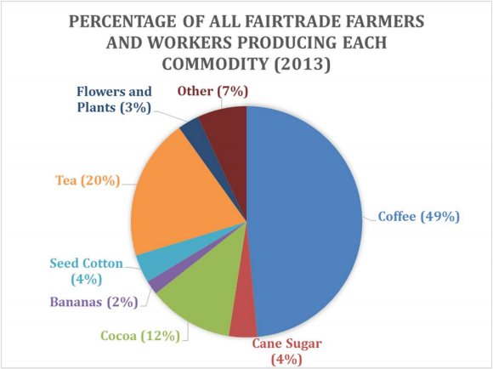
Fair trade and global commodities
© 2017 Taylor & Francis

Slide 14
Critiques of fair trade
1. Aligning with major corporations, who gain consumer appeal
by selling only a small proportion of fair-trade coffee;
• Only 8% of Starbucks coffee is fair-trade.
2. A market-based strategy cannot change global inequalities;
and
3. Fair Trade USA has certified large, corporate plantations.
Potential effect: decreased consumer confidence in fair-trade label.
• Do you drink fair-trade coffee? Why or why not?
© 2017 Taylor & Francis

Slide 15
Research tool: survey research
Administering a standardized questionnaire to a sample of respondents, and analyzing their responses.
Sample: a small subset of respondents, representative of a larger population research is interested in.
• You are interested in coffee-drinking habits of students at your
university/college. Do you need to get each and every one of them to fill out a survey? How will you choose your respondents?
A quantitative method: data are numerical.
Goal: compare characteristics, opinions and actions across individuals and groups in the population.
• You want to find out if there are differences in coffee-drinking habits of men and women. Which questions do you need to ask in order to find this out?
© 2017 Taylor & Francis

